Slide 1


Slide 2


Slide 3
H M T
WHY THIS BUSINESS ?
HEALTH
MONEY
TIME

Slide 4


WE
WE ARE IN THE PRE-LAUNCHING PHASE

Slide 5
A GOOD DIRECT SELLING COMPANY
UNIQUE & TOP QUALITY PRODUCTS
AFFORDABLE PRODUCT THAN ONLINE AND OFFLINE STORES
ATTRACTIVE INCOME PLAN
GREAT EDUCATION SYSTEM
STRONG BUT DOWN TO EARTH MANAGEMENT
AWESOME FEATURES

Slide 6
ADVANCEMENT GLOBAL VENTURE PVT. LTD.

Slide 7
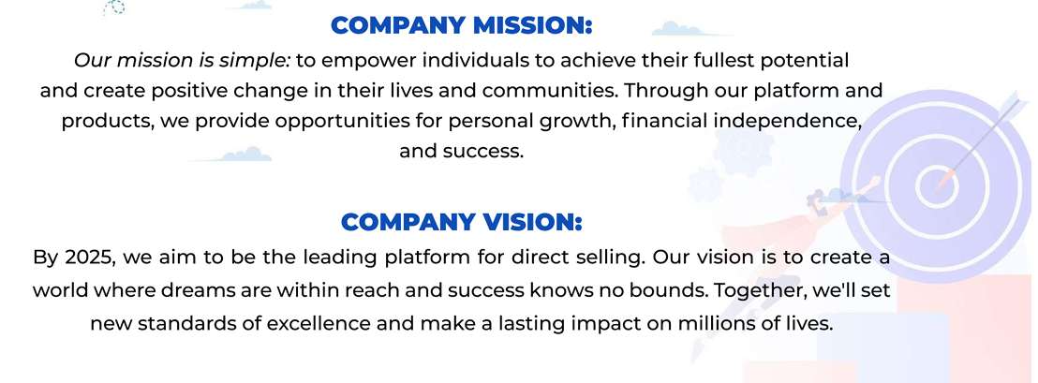
MISSION & VISION

Slide 8

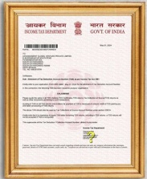
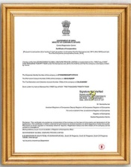
OUR CERTIFICATES

Slide 9
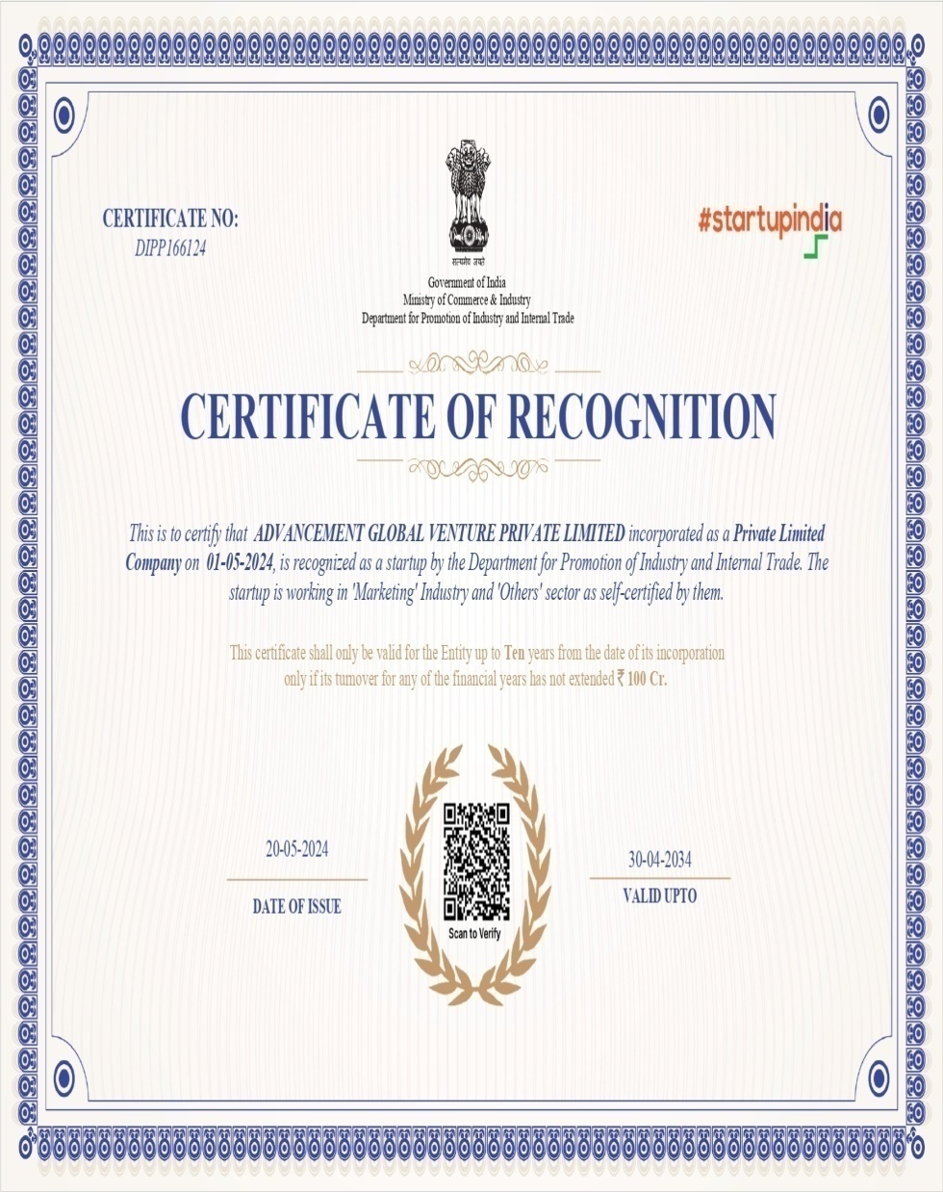
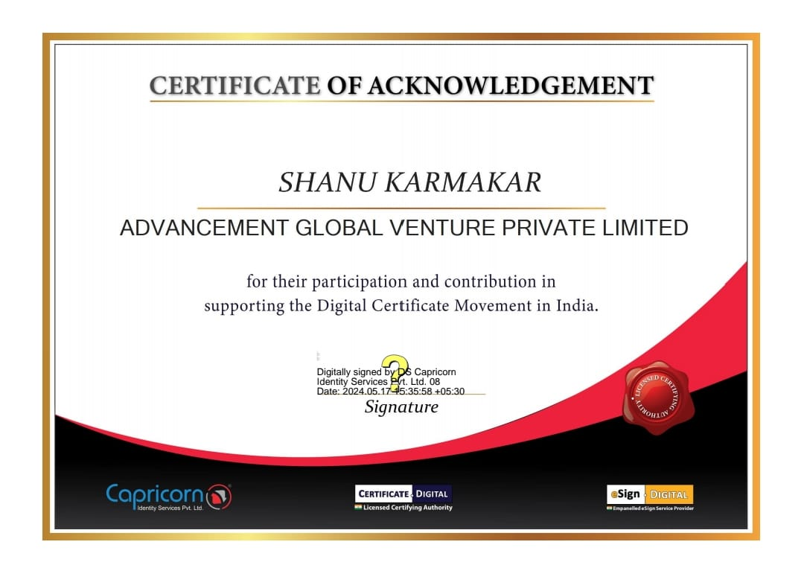

Slide 10


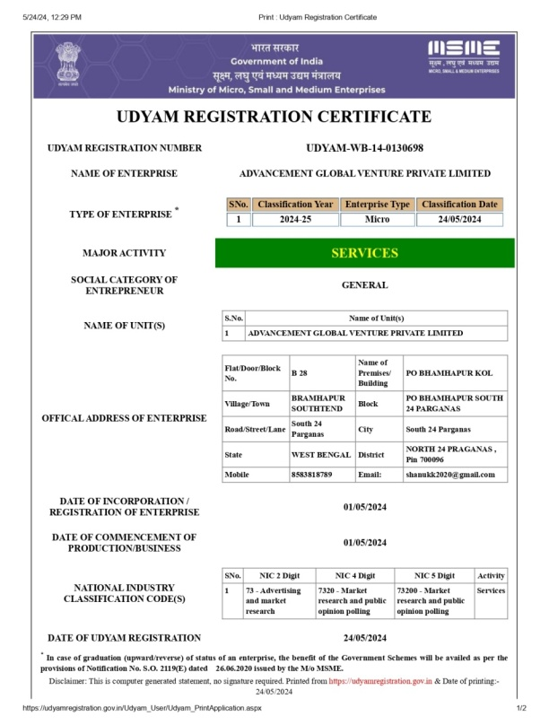
OUR CERTIFICATES

Slide 11


OUR CERTIFICATES

Slide 12


OUR CERTIFICATES

Slide 13


OUR CERTIFICATES

Slide 14
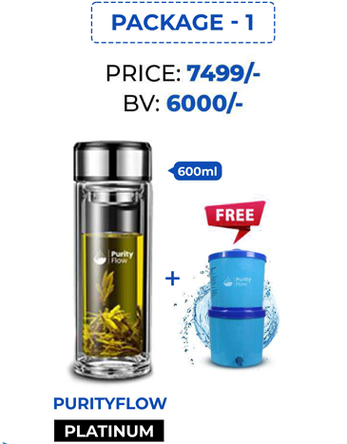
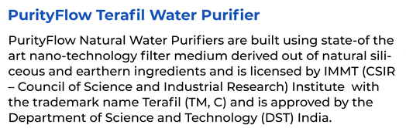
OUR PRODUCTS
PACKAGE 1
M.R.P - Rs 8499
D.P – Rs 7499
BV - 5500
Get Rs 1000 Discount At D.P

Slide 15
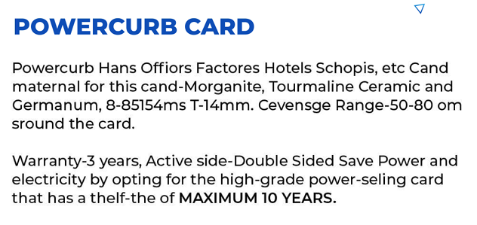
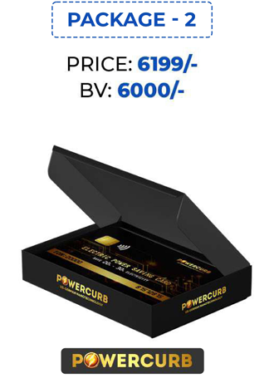
OUR PRODUCTS
PACKAGE 2
M.R.P - Rs 7199
D.P – Rs 6199
BV - 5000
Get Rs 1000 Discount At D.P

Slide 16
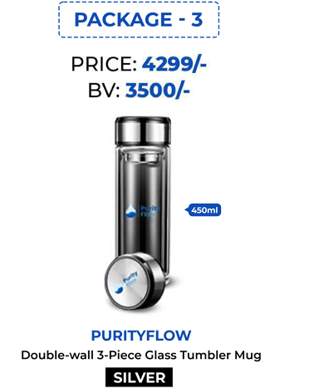

OUR PRODUCTS
PACKAGE 2
M.R.P - Rs 4799
D.P – Rs 4299
BV - 3000
Get Rs 500 Discount At D.P

Slide 17

WELCOME BONUS
YOU
LEFT
RIGHT
5500 BV
5500 BV
Rs 550
Rs 550
Total Welcome Bonus Upto Rs 1,100
*Terms & Conditions Applied

Slide 18
MATCHING INCOME
YOU
LEFT
RIGHT
5500 BV
5500 BV
Matching Income = 20% of BV Matched
Upto Rs 1,100
*Terms & Conditions Applied

Slide 19
MATCHING INCOME
YOU
LEFT
RIGHT
Note : For Your Matching Payout, You Are Required To Have A Ratio Of 2:1 or 1:2
*Terms & Conditions Applied

Slide 20

LEVEL BONUS
Level | Rs
1st | Upto 30
2nd | Upto 30
3rd | Upto 30
4th | Upto 20
5th | Upto 20
6th | Upto 20
7th | Upto 20
8th | Upto 20
9th | Upto 15
10th | Upto 15
11th | Upto 15
12th | Upto 15
YOU
LEFT
RIGHT
Upto 5500 BV
Upto 5500 BV
Rs 30
Rs 30
Level Bonus = Rs 60
*Terms & Conditions Applied

Slide 21
TOTAL BENIFIT
YOU
LEFT
RIGHT
Upto 5500 BV
Upto 5500 BV
Welcome Bonus = Rs 1,100
Matching Income = Rs 1,100
Level Bonus = Rs 60
Total Benefit = Rs 2,260
Note : Weekly Capping Upto Rs 75,000
*Terms & Conditions Applied

Slide 22
ROYALTY INCOME
*1% of company’s total turnover will be equally distributed among the Achievers*
RANK | CRITERIA
ROYALTY | 1,50,000 BV Match
SUPER ROYALTY | 3,00,000 BV Match
EXECUTIVE ROYALTY | 6,00,000 BV Match
CHIEF ROYALTY | 15,00,000 BV Match
PREMIUM ROYALTY | 30,00,000 BV Match
*Terms & Conditions Applied

Slide 23


Slide 24









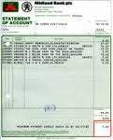
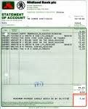

FESTIVALS PARTY etc
HOME LOAN/ RENT
MEDICAL
INCOME
FOOD
CAR LOAN/ PETROL
CLOTHES
HIGHER EDUCATION
HOLIDAY
BILLS
SCHOOLING

Slide 25









NOMINEE
LEFT
RIGHT
B
C
D
E
F
5,000/-
15,000/-
30,000/-
60,000/-
75,000/-
*Terms & Conditions Applied

Slide 26


ADVANCEMENT GLOBAL
VENTURE PVT. LTD
ouradvancement.com

